Slide 1
Bridge Networks
EEE Lecture-11

Slide 2
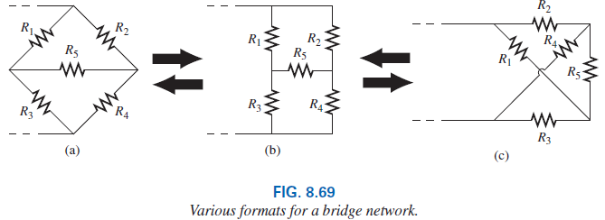
8.11 Bridge Networks
The bridge network may appear in one of the three forms.

Slide 3
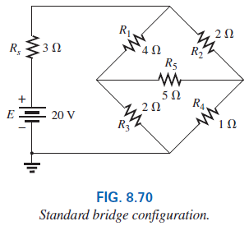
8.11 Bridge Networks
For the purposes of investigation, let us examine the network of Fig. 8.64 using mesh and nodal analysis.

Slide 4
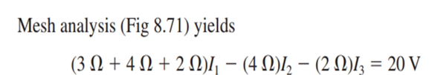
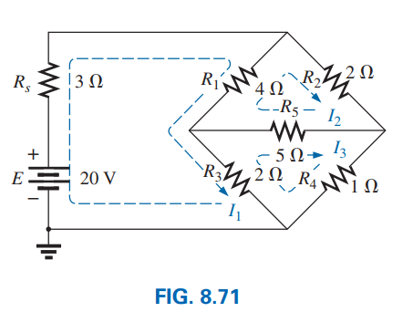
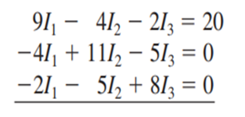
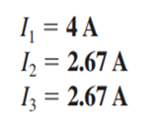
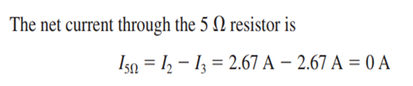
8.11 Bridge Networks

Slide 5
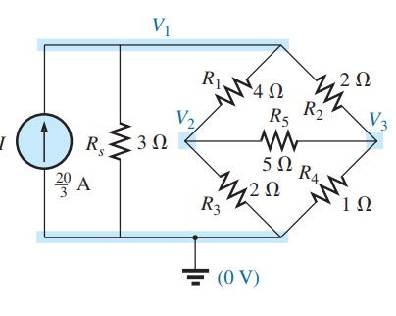
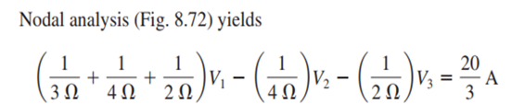


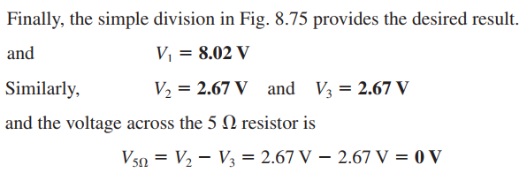
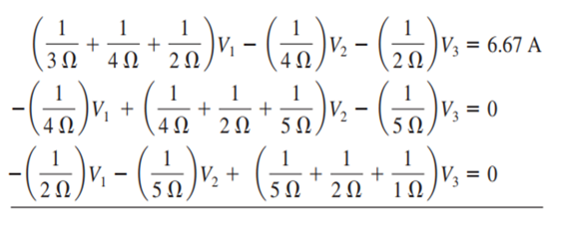
8.11 Bridge Networks

Slide 6
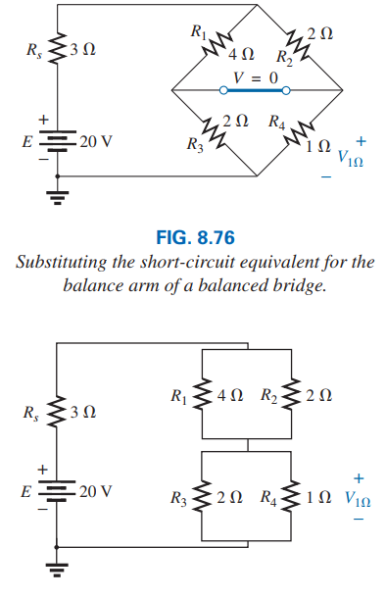
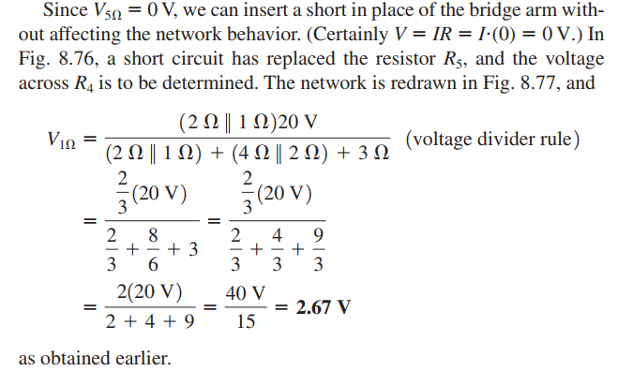
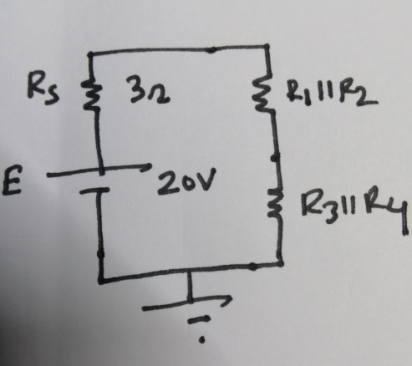
8.11 Bridge Networks

Slide 7
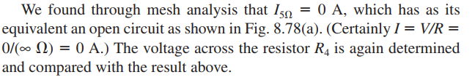
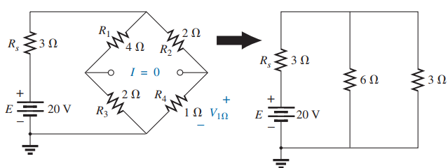
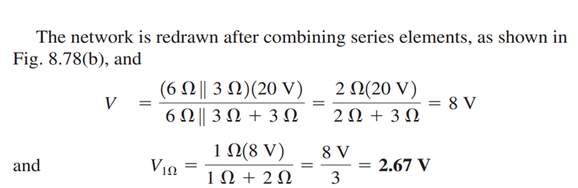
8.11 Bridge Networks

Slide 8
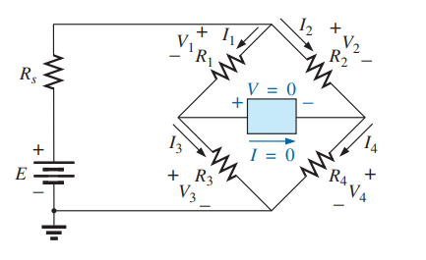
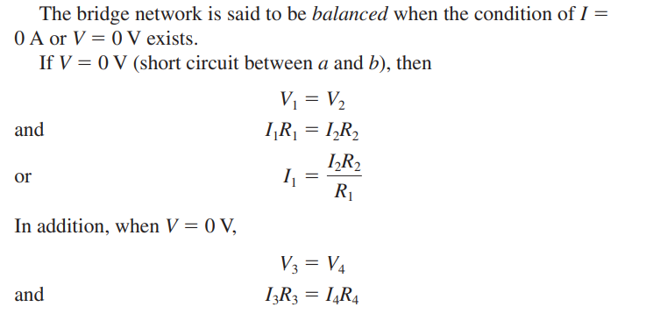
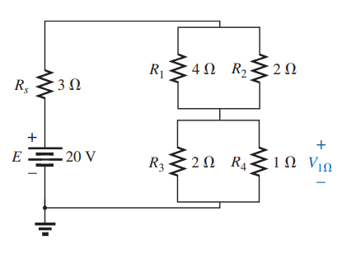
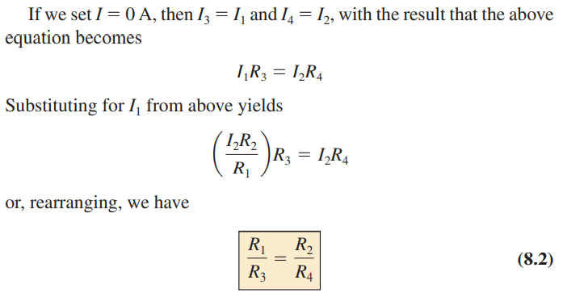
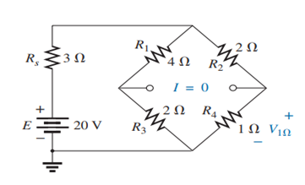

Slide 9
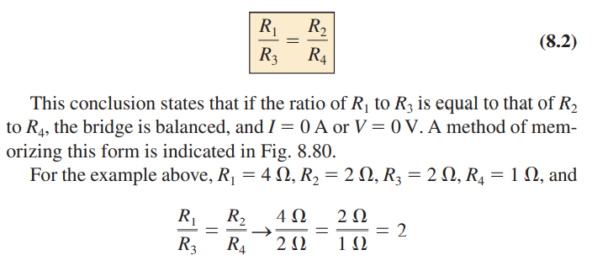
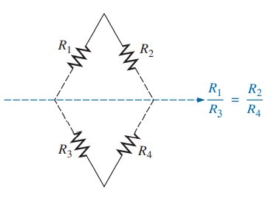

Slide 10
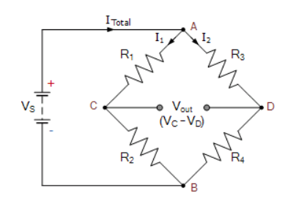
Wheatstone Bridge
The Wheatstone Bridge was originally developed by Charles Wheatstone to measure unknown resistance values.
The Wheatstone Bridge circuit is nothing more than two simple series-parallel arrangements of resistances connected in a bridge network.

Slide 11
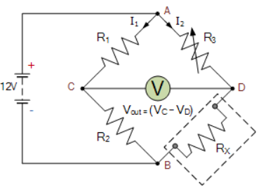

Wheatstone Bridge Circuit
R1 and R2, have fixed values, and R3 is a variable resistor.
What would be the value of unknown resistance R_{X}?
If we connected a voltmeter or ammeter between points C and D, and then varied resistor, R₃ until the meters read zero, would result in the two arms being balanced and the value of R_{X} which is equal to
R_{x} = R₂.R₃ = R₄
R₁
Since when bridge circuit is balanced.

Slide 12
8.12
Circuit configurations are often encountered in which the resistors do not appear to be in series or parallel.
Under these conditions, it may be necessary to convert the circuit from one form to another to solve for any unknown quantities.

Slide 13
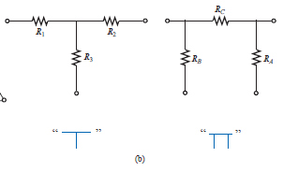
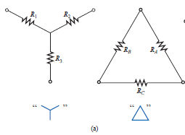
Two circuit configurations that often account for these difficulties are the wye (Y) and delta (Δ) configurations.
They are also referred to as tee (T) and pi (Π), configurations are indicated in Fig (b).

Slide 14
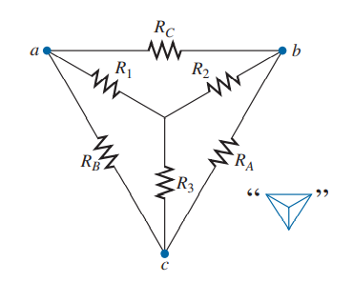
It is our purpose to find some expression for R₁, R₂, and R₃ in terms of R_{A}, R_{B}, and R_{C} , and vice versa, that will ensure that the resistance between any two terminals of the Y configuration will be the same with the configuration inserted in place of the ∆ configuration (and vice versa).
If the two circuits are to be equivalent, the total resistance between any two terminals must be the same.

Slide 15
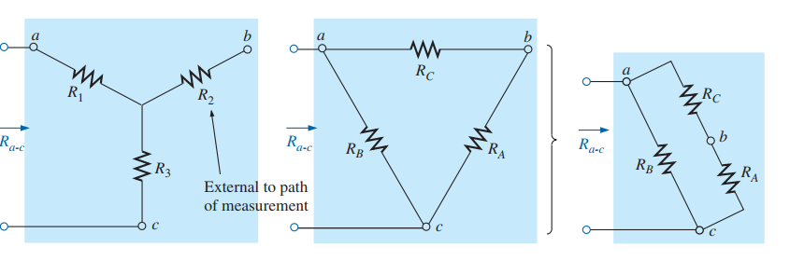
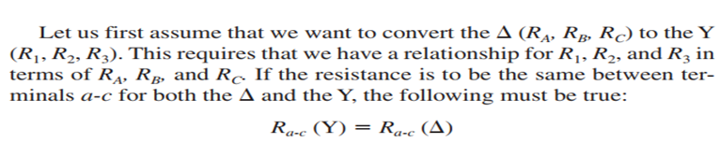
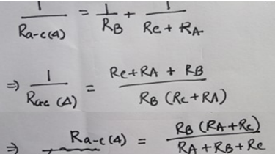


Slide 16

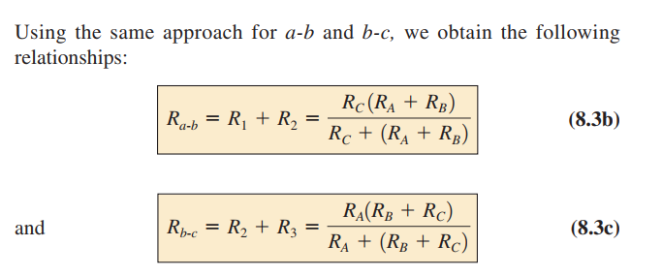
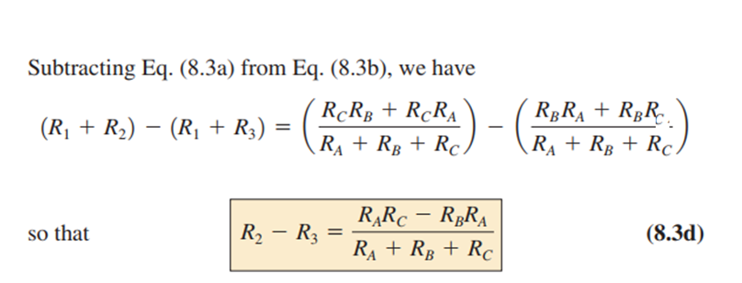

Slide 17
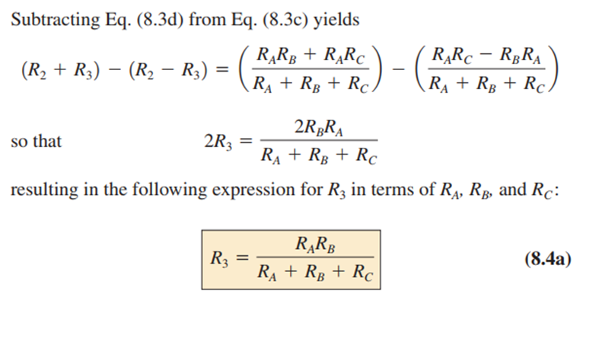

Slide 18
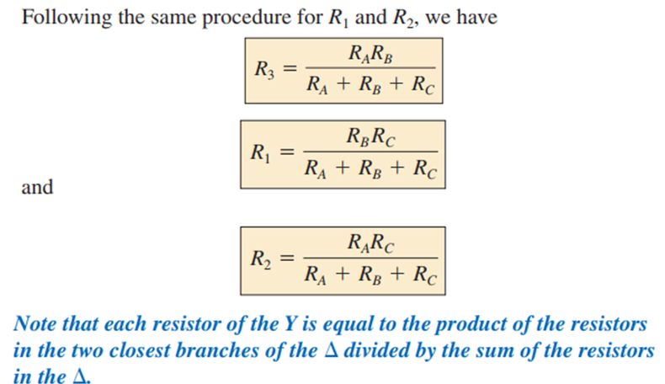
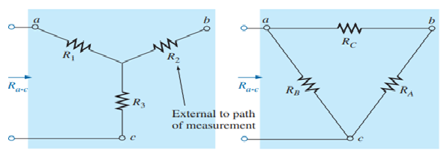

Slide 19
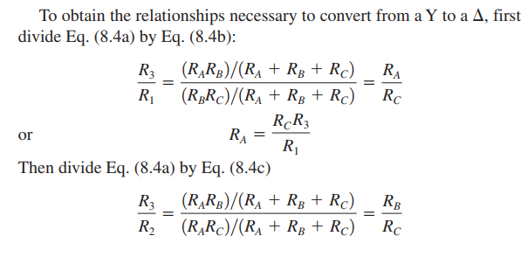
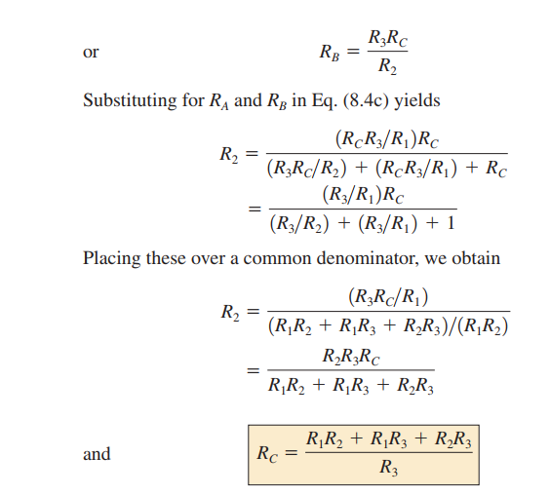

Slide 20
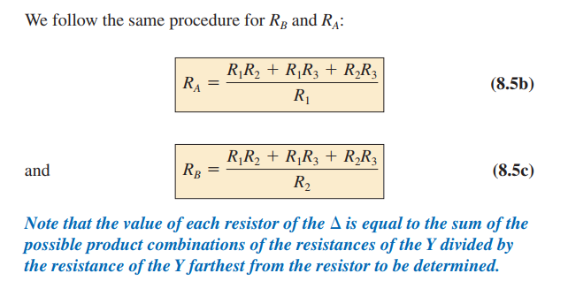

Slide 21
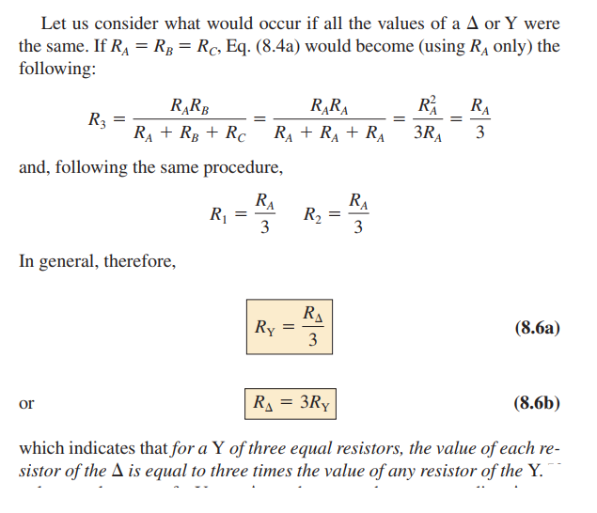

Slide 22
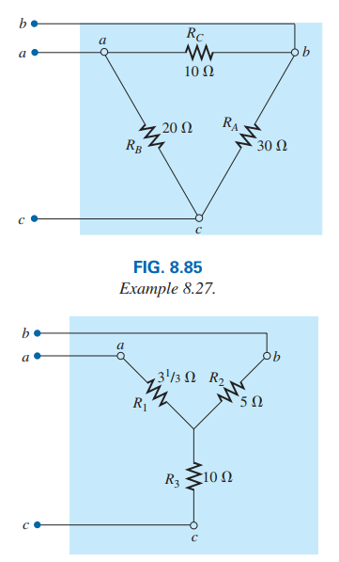
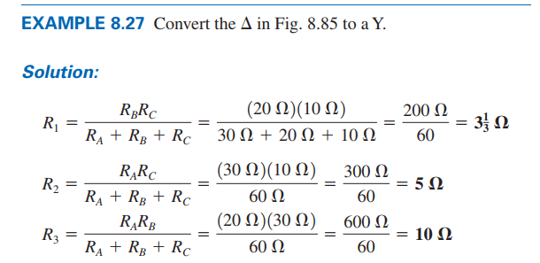

Slide 23
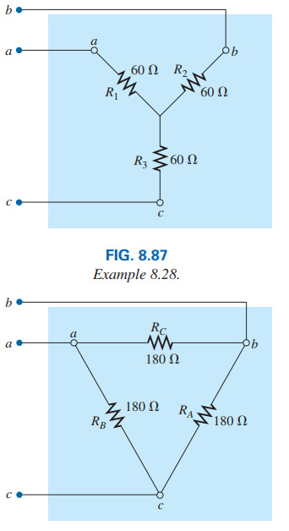
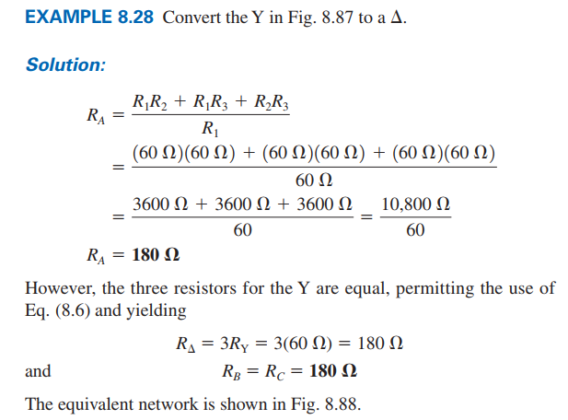

Slide 24
Thank You

